Slide 1
MEA
UNIT-2
CONSUMER BEHAVIOUR

Slide 2
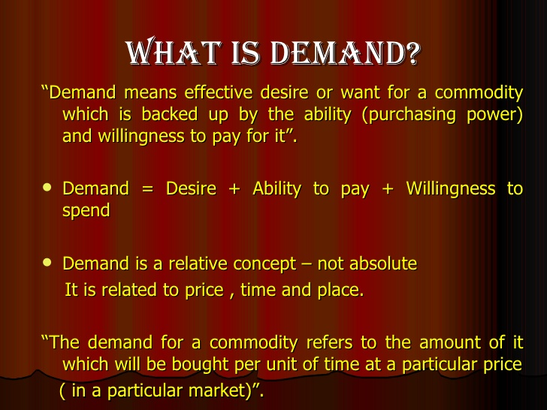

Slide 3
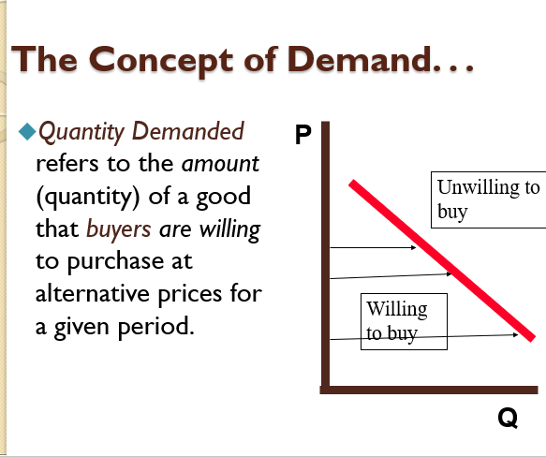

Slide 4
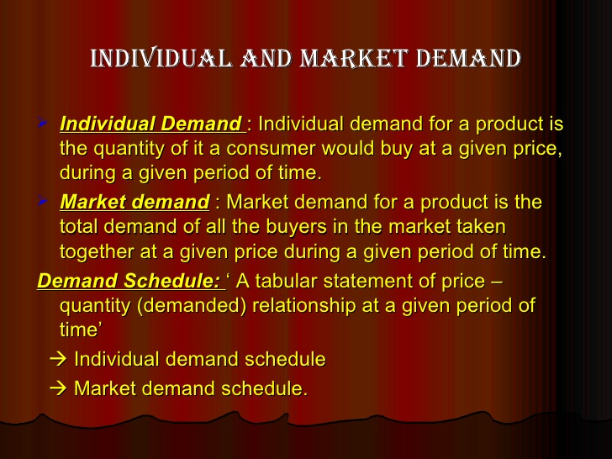

Slide 5
The law of Demand:-
―Other things remaining the same (ceteris paribus), the quantity demanded of a commodity is inversely related to its price.
DX= f(PX)
D= Demand P= PriceD= f (P) Where
D= Demand
P= Price
f = Functional Relationship
f = Functional Relationship
Demand is a dependent variable, while the price is an independent variable.

Slide 6
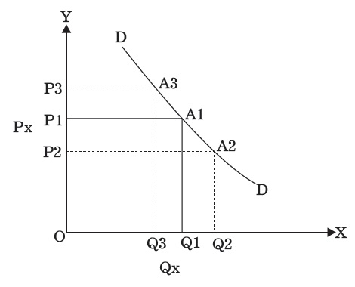
DEMAND SCHEDULE OF A
Prices(Rs) Quantity demanded(in units)
10 20
8 30
6 40
4 50
It is seen from the table that when the price of the commodity is Rs 10 per unit,
―A purchases 20 units of the commodity. When the price falls to Rs 8, he purchases 30 units of
the commodity. Similarly, when the price further falls, quantity demanded by ―A‖ goes on rising.

Slide 7
ZEN (IN ₹ PER DOZEN) | QUANTITY DEMANDED BY A (IN DOZENS PER WEEK) | QUANTITY DEMANDED BY B (IN DOZENS PER WEEK) | TOTAL MARKET DEMAND (A + B) (IN DOZENS PER WEEK)
(1) | (2) | (3) | (4)
80 | 2 | 4 | 2 + 4 = 6
70 | 4 | 6 | 4 + 6 = 10
60 | 6 | 10 | 6 + 10 = 16
50 | 9 | 15 | 9 + 15 = 24
40 | 14 | 22 | 14 + 22 = 36

Slide 8
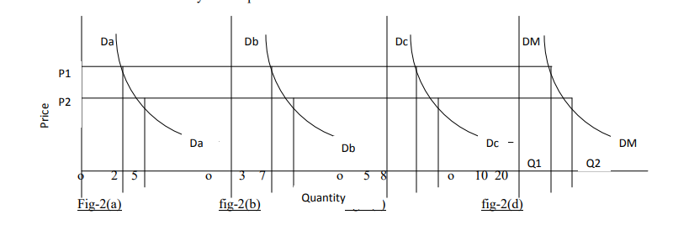

Slide 9
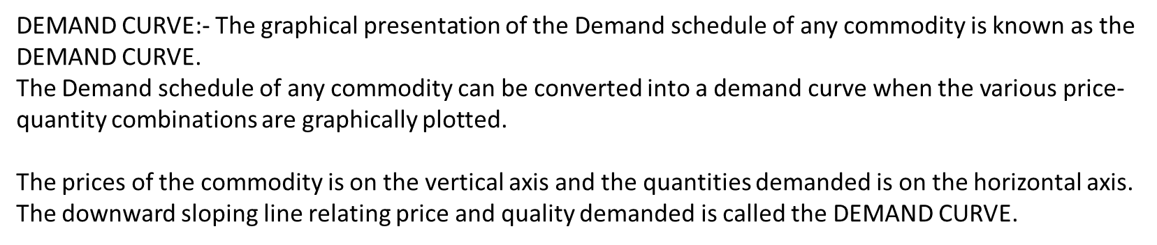

Slide 10
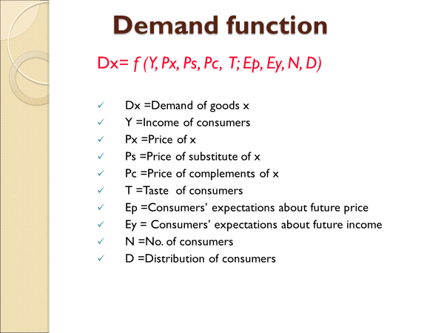

Slide 11
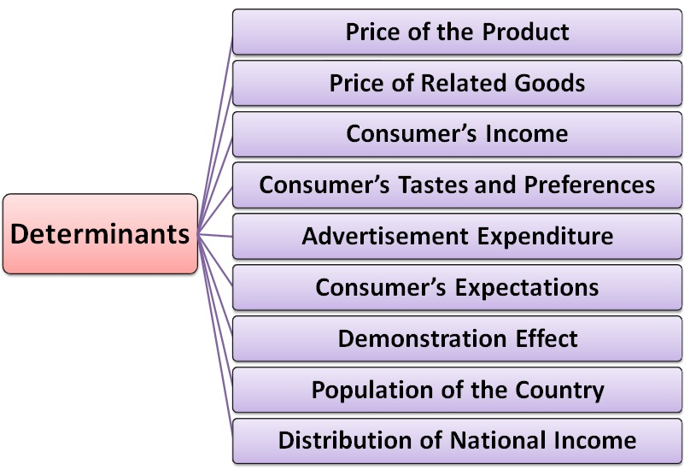

Slide 12
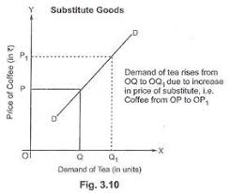
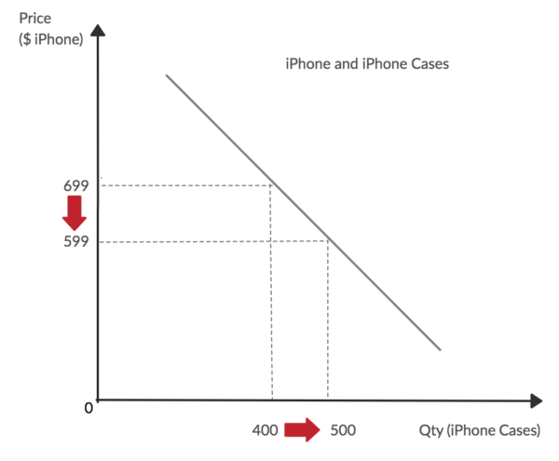

Slide 13
Inferior Goods: A commodity is deemed to be inferior if its demand decreases with the increases in the consumer’s income beyond a certain level of income and vice-versa. For example, Bajra, millet, bidi are the inferior goods.
Normal Goods: The normal goods are those goods whose demand increases with the increase in the consumer’s income, such as clothing, household furniture, automobiles, etc.
It is to be noted that, demand for the normal goods increases rapidly with the increase in the consumer’s income but slows down with a further increase in the income.
Luxury Goods: The luxury goods are those goods which add to the prestige and pleasure of the consumer without enhancing the earnings. For example, jewelry, stone, gem, luxury cars, etc. The demand for such goods increases with the increase in the consumer’s income.

Slide 14
Advertisement Expenditure:
Advertisement is done to promote sales of a product.
It helps in stimulating demand for a product in four ways;
by informing the prospective consumers about the availability of a product,
by showing its superiority over the competitor’s brand,
by influencing the consumer’s choice against the rival product and
by setting new fashion and changing tastes of the consumers.
The effect of advertisement is said to be fruitful if it leads to the upward shift in the demand curve, i.e. the demand increases with the increase in the advertisement expenditure, other things remaining constant

Slide 15
Demonstration Effect: Often, the new commodities or new models of an existing product are bought by the rich people.
Some people buy goods due to their genuine need for them or have excess purchasing power. While some others do so because they want to exhibit their affluence.
Once the commodity is in very much fashion, many households buy them not because they have a genuine need for them but their neighbors have purchased it.
Thus, the purchase made by such people arises out of feelings as jealousy, equality in society, competition, social inferiority, status consciousness.
The purchases made on the account of these factors results in the demonstration effect, also called as Bandwagon Effect.
Consumer-Credit Facility: The availability of credit to the consumer also determines the demand for a product. The credit extended by sellers, banks, friends, relatives or from other sources induces a consumer to buy more than what would have not been possible in the absence of the credit.
Thus, the consumers with more borrowing capacity consumes more than the ones who borrow less.

Slide 16
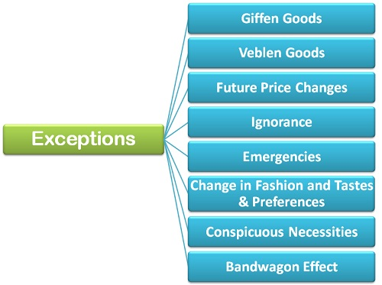

Slide 17
Giffen Goods: Giffen goods are the inferior goods.
Whenever the price of the Giffen goods increases its quantity demanded also increases because, with an increase in the price, and the income remaining the same, the poor people cut the consumption of superior substitute and buy more quantities of Giffen goods to meet their basic needs.
Veblen Goods: Another exception to the law of demand is given by the economist Thorstein Veblen, who proposed the concept of “Conspicuous Consumption.” According to Veblen, there are a certain group of people who measure the utility of the commodity purely by its price, which means, they think that higher priced goods and services derive more utility than the lesser priced commodities.For example, goods like a diamond, platinum, ruby, etc. are bought by the upper echelons of the society (rich class) for whom the higher the price of these goods, the higher is the prestige value and ultimately the higher is the utility or desirability of them.

Slide 18
Expectation of Price Change in Future:
When the consumer expects that the price of a commodity is likely to further increase in the future, then he will buy more of it despite its increased price in order to escape himself from the pinch of much higher price in the future and vice-versa. e.g. Gold rates
Ignorance: Often people are misconceived as high-priced commodities are better than the low-priced commodities and rest their purchase decision on such a notion. They buy those commodities whose price are relatively higher than the substitutes.

Slide 19
Emergencies: During emergencies such as war, natural calamity- flood, drought, earthquake, etc., the law of demand becomes ineffective. In such situations, people often fear the shortage of the essentials and hence demand more goods and services even at higher prices.
Change in fashion and Tastes & Preferences: The change in fashion trend and tastes and preferences of the consumers negates the effect of law of demand. The consumer tends to buy those commodities which are very much ‘in’ in the market even at higher prices.

Slide 20
Conspicuous Necessities: There are certain commodities which have become essentials of the modern life. These are the goods which consumer buys irrespective of an increase in the price. For example TV, refrigerator, automobiles, washing machines, air conditioners, etc.
Bandwagon Effect: This is the most common type of exception to the law of demand wherein the consumer tries to purchase those commodities which are bought by his friends, relatives or neighbors.
Here, the person tries to emulate the buying behavior and patterns of the group to which he belongs irrespective of the price of the commodity.For example, if the majority of group members have smart phones then the consumer will also demand for the smartphone even if the prices are high.

Slide 21
Thus, these are some of the exceptions to the law of demand where the demand curve is upward sloping, i.e. the demand increases with an increase in the price and decreases with the decrease in price.
Why demand curve slopes downwards?:-
Law of diminishing marginal utility:-
The consumer would purchase only as many units of the commodity, where the marginal utility of the commodity is equal to its price and accordingly maximize his satisfaction. If price falls, the consumer will be motivated to demand more units of the commodity and vice-versa.

Slide 22
B) Substitution effect:-
When the price of a commodity falls, the consumer is induced to substitute more of the relatively cheaper commodity (one whose price has fallen) for the dearer one (whose price has remained unchanged). Since, substitution effect is always positive, a larger quantity of the commodity will be purchased at a lower price and vice-versa.
C) Income effect:- This refers to the changes in the real income of the consumer due to changes in price.
Thus, with the fall in the price of the commodity, the purchasing power of the real income of the consumer will rise, i.e. the consumer can now purchase the same amount of commodity with less money or he can now purchase more with the same money. The reverse also holds good.

Slide 23
Law of Supply
Any discussion on demand cannot be complete without understanding supply.
Demand and Supply are like two sides of a coin or two blades of scissors.
Demand indicates the willingness of a purchaser to buy a particular commodity, supply means the willingness of the firms to sell a particular commodity.
Supply refers to the quantities of a good or service that the seller is willing and able to provide at a price, at a given point of time, ceteris paribus.

Slide 24
The Law of supply states that other things remaining the same, the higher the price of a commodity, the grater is the quantity supplied.
Supply Function:
Sx = f(Px, C, T, G, N)
Where C= Cost of Production(wages, interest, rent and price of raw materials)
T = State of technology
G = Govt. policy regarding taxes and subsidies
N = No. of firms

Slide 25
Determinants of Supply
Supply is positively related to price of the commodity.
Supply is reduced if the cost of production rises.
Technology bears a positive relationship with supply. An improved techology reduces cost of production per unit of output, enhances productivity and thus increases the supply of the product.
Government policies related to taxes and subsidies on certain products also have an effect on supply as they increase or decrease the cost. Such effects may be either negative (in case of taxes) or positive (in case of subsidies).

Slide 26
No of firms: With increase in the number of producers of a particular product, the supply of the product in the market will increase.
If entry is unrestricted, new firms will continue to enter the market, thus increasing supply and degree of competition. (Perfectly Competitive market, in the long run, as more firms enter into the industry, the aggregate supply curve of the product shifts to the right (or left) due to an increase in the supply of the product.)

Slide 27
Shift in Demand Curve
Shift of demand curve due to a change in any of the factors other than price is a change in demand.
When demand increases without any change in price, the demand curve will shift to the right, and with a reduction in demand, the curve will shift to the left.
Demand curve shifts to the right if income rises and shifts to the left if income falls, ceteris paribus.

Slide 28
Change in Demand
Shift in demand curve from D₀ to D₁
More is demanded at same price (Q₁>Q)
Increase in demand caused by:
A rise in the price of a substitute
A fall in the price of a complement
A rise in income
A redistribution of income towards those who favour the commodity
A change in tastes that favours the commodity
Shift in demand curve from D₀ to D₂
Less is demanded at each price (Q₂<Q)
Price
D₁
D₀
D₂
P
0
Q₂
Q₁
Q
Quantity

Slide 29
Concept of Elasticity
Elasticity can be defined as “the proportionate change in demand of product in response to the proportionate change in any of the factors affecting demand”. The benefit of concept of elasticity that it shows the amount of change in the demand.
When the law of demand only shows the direction of change in demand, the elasticity of demand shows the direction as well as the % change in demand. So, Elasticity of demand is more useful concept than price.

Slide 30
Concept of Elasticity
Elasticity is a measure of the sensitiveness of one variable to changes in some other variable.
It is expressed in terms of a percentage and is devoid of any unit of measurement.
Elasticity of a variable x with respect to variable y is expressed as ex,y.
ex,y = % change in x
% change in y

Slide 31
Demand Elasticities
Demand elasticities refer to elasticities of demand for a good with respect to each of the determinants of its demand.
Price elasticity of demand
Income elasticity of demand
Cross elasticity of demand
Promotional elasticity of demand

Slide 32
Price elasticity of demand
Price elasticity can be defined as “the proportionate change in demand of product in response to the proportionate change in price of a product.’
Ep= % change in demand of X
% change in price of X
Price Elasticity of Demand is negative since there is an inverse [negative] relationship between price and the demand of the product. If price increase, demand decrease, if price decrease, demand increases.

Slide 33
Types of price elasticity
Perfectly elastic demand ( e = α)
When an insignificant or minor change in the price will result in an extra ordinary large change in demand, the demand is said to be a perfectly elastic. A slight change means a slight decrease in the price will result in the increase in demand to infinity and a slight increase in the price will lead to the decrease in demand to ‘0’. But in actual situation the demand cannot be perfectly elastic.

Slide 34
2. Perfectly inelastic demand: (e = 0)
When the demand for the commodity remains constant irrespective of the change in the price of commodity.
There is hardly any commodity in the world for which this is true.
For ex: salt. Salt is an inexpensive and yet an essential consumption item and its consumption can vary only within a small range.
For this reason alone, its consumption hardly varies with variations in its price.

Slide 35
3. Unitary elastic demand: (e = 1)
When the percentage change in the price of a commodity brings about the same percentage change in the demand of the commodity, the demand is said to be unitary elastic. For, e.g., 5% increase or decrease in the price will result in 5% decrease or increase in demand for the commodity.

Slide 36
4. Elastic demand [ e > l ]
In this case changes in price leads to a more than proportionate change in demand. For, e.g., if the price of commodity X changes by 2 %, the demand for X will change by more than 2%.
Most luxury items have elastic demands.

Slide 37
5. Inelastic demand [ e < l ]
In this case changes in price leads to a less than proportionate change in demand. For, e.g., if the price changes 2% the demand changes by less than 2%.
A large number of goods and services, which include all the essential items, have inelastic demand.

Slide 38
Income Elasticity of Demand
We know the income of the consumer is an important determinant of demand.
Although income does not vary in the short run, its impact on long term demand analysis in very crucial.
Therefore it is useful to learn income elasticity of demand (ey).
Income elasticity of demand measures the degree of responsiveness of demand for a commodity to a given change in consumer’s income.
Assume that all other variables are ceteris paribus.

Slide 39
Income elasticity of demand
The Income Elasticity expresses the relationship between the % change in income and corresponding % change in demand for a particular commodity.
It measure the % change in demand due to % change in the income of consumers
ey = % change in demand of X
% change in income of consumer
ey = Q2 – Q1/Q1
Y2 – Y1/ Y1

Slide 40
Degrees of Income Elasticity
Income elasticity of demand also has similar degrees of price elasticity of demand, namely perfectly elastic, perfectly inelastic, relatively elastic, relatively inelastic and unitary elastic.
Hence, when the proportionate change in demand is more than that in income, demand is highly elastic; when the proportionate change in demand is less than that of income, demand is highly inelastic.

Slide 41
Normally the demand for commodity has a tendency to increase as income increases, so income Elasticity is generally positive, but this may not be saw in case of inferior goods.
The demand for inferior goods reduces as the income of the consumer increases because higher income leads to the use of superior quality of goods.
Hence the value of income elasticity can be either negative or positive, depending upon nature of product.

Slide 42
Degrees of Income Elasticity
Positive Income Elasticity
Zero Income Elasticity
Negative Income Elasticity

Slide 43
Positive Income Elasticity
A good that has positive income elasticity is regarded as normal good.
A normal good is one which a consumer buys in more quantities when his income increases.
Ex : Clothes, fruits, jewellery, etc.

Slide 44
Zero Income Elasticity
Zero income elasticity implies that there is no change in the demand for a commodity when there is a change in income. Such goods are called neutral goods.
Ex: match box, salt, needles, postcard etc.

Slide 45
Negative Income Elasticity
It implies that demand for a commodity decreases as the income of the consumer increases.
A good that has negative income elasticity of demand is regarded as an inferior good. i.e. The consumer buys less of such a good when his income increases and consumer would switch over consumption to superior quality of good with increase in income.
Ex : Poor quality of food, clothes etc.

Slide 46
Income Elasticity of demand is-
Positive for superior /normal goods
Negative for interior good
Positive and More than 1 for all luxuries goods
Positive and around unity for all comforts goods.
Positive and Less than 1 for all superior and necesssary goods
May be 0 for the products like salt, match box, needle, etc

Slide 47
Cross Elasticity of Demand
Demand for commodity is influents not only by price commodity and income, but also by the price of other commodity. It expresses the relationship between a change in demand for a commodity due to change in the price of some other commodity. It measures the proportionate change in demand due to proportionate change in price of some other commodity. Ec of product is negative. For, e.g., tea & coffee in case of substitute goods.
Ey = % change in demand of X
% change in Price of Y
It is positive if goods x and y are substitutes in the consumption basket, negative if they are complements, and zero if the two goods are unrelated.
The greater the magnitude of this elasticity, the stornger is the relationship between two goods.

Slide 48
Positive Cross Elasticity:-
Substitute goods are those which compact with each other. For, e.g., tea, coffee etc. For substitutes goods the cross elasticity is positive.
Generally if the price of tea falls, the demand of tea rise and at the same, time tea become cheaper than coffee. So, some of the customer currently consuming coffee will start consuming tea instead of coffee. So the demand of coffee reduces.
For substitutes quantity demanded of one good moves in the same direction as the price of the other.
Ex : coke and pepsi, zen and santro, etc.

Slide 49
Negative Cross Elasticity:
Complementary goods are those goods which have to be consumed simultaneously it means if a consumer wants to consume one product he has to consume other product.
For complements, quantity demanded of one good moves in the opposite direction as the price of the other.
For, e.g., car & petrol. Elasticity for complementary goods is negative. If the price of car reduces, the demand for it increases and at the same time the requirement of petrol also increases, which will increases the demand for it.
Ex: bread and butter, tea and sugar, pen and ink, etc.

Slide 50
Zero Cross elasticity:
Ec for unrelated goods is zero because one commodity does not affect the other commodity if the price of one commodity changes it will not affect the demand for other commodity. If the price of tea changes by 2% it will not create any affect on the demand of clothes.

Slide 51
Promotional Elasticity of Demand
Advertising and promotion are vital tools in the competitive market to generate awareness about its products.
Promotional elasticity of demand measures the degree of responsiveness of demand to a given change in advertising expenditure.
It must obviously be positive, for advertisement expenditures are supposed to boost up the market.
Some goods (like consumer goods) are more responsive to advertising than others (like heavy capital equipments)

Slide 52
When Ea > 1, a firm should go for heavy expenditure on advertisement.
When Ea < 1, a firm should not spent too much on advertisement because the product is not sensitive to promotion.
For Ex: we find the advertisement for lubricants, generators, inverters, etc. but would not find advertisements for electricity, petrol or diesel.

